Slide 1









Manuela MERLO
Riccardo INGHILLERI
Habits Tracker
Professor Luciano BARESI
Tutor Marco DE ROSSI

Slide 2
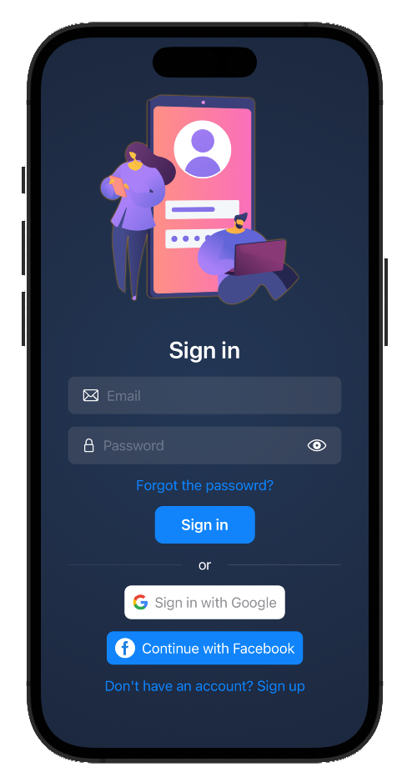
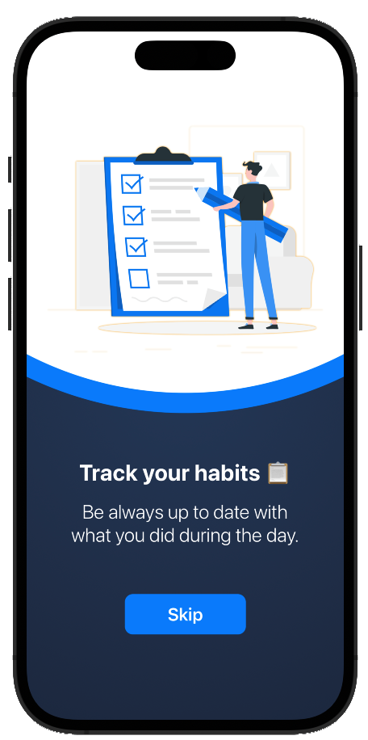



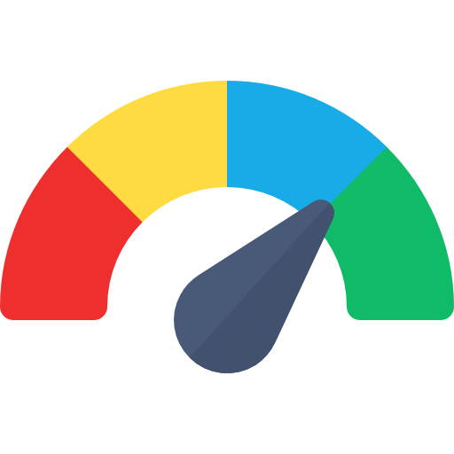
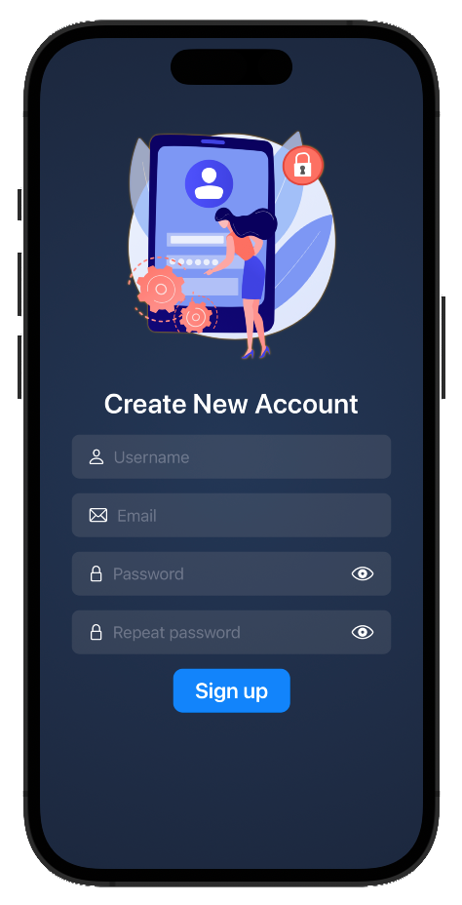


Goal
Features
Get a healthy daily routine
Compete with your friends
Multiple Sign-In
Profile Customisation
Health Data integration
Point System
Social integration
Notifications
Points of interests
Notes:
Our application aims to solve the lack of motivation or a difficulty in integrating health habits into the daily routine by not only keeping track of these activities, but by making them a game.
By introducing point systems, records and leaderboards, we have turned the often monotonous task of health tracking into a fun and competitive activity.

Slide 3
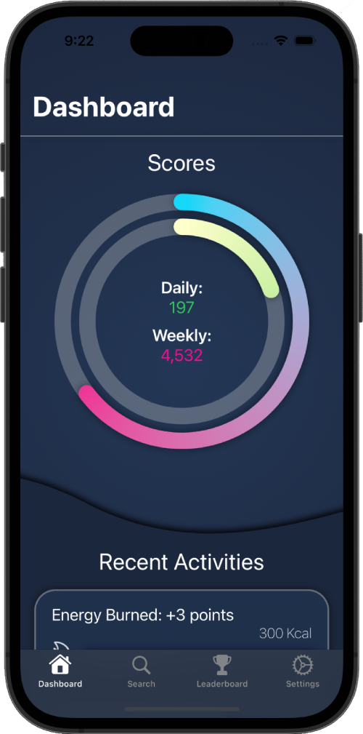
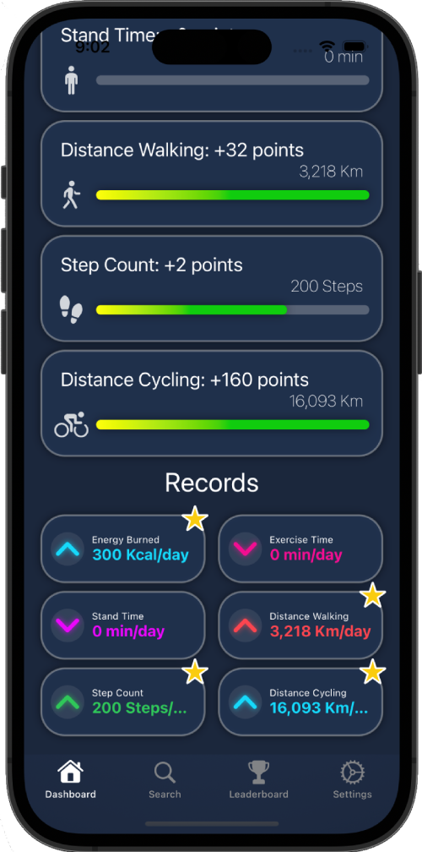
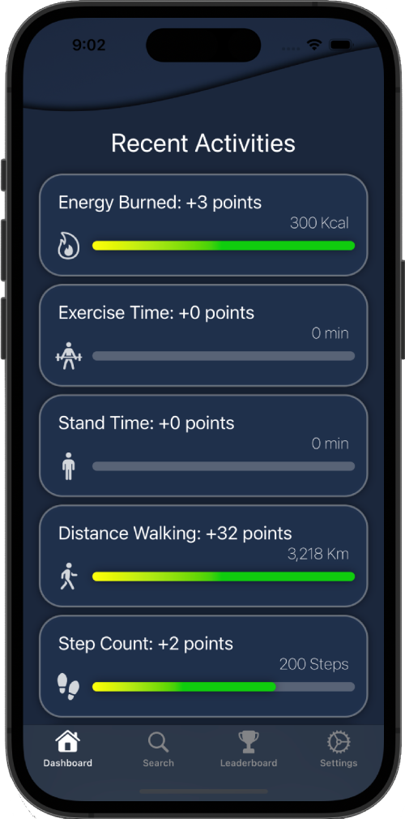
MVVM
Components:
Model: Houses data representation, detached from app logic.
View: Renders UI elements and controls.
View Model: Bridges Model and View, managing display logic.
Notes:
MVVM offers a structural framework, ensuring maintainable, testable, and extensible software.Its core advantage lies in clear UI-business logic separation, preventing monolithic views and enabling a modular codebase.

Slide 4
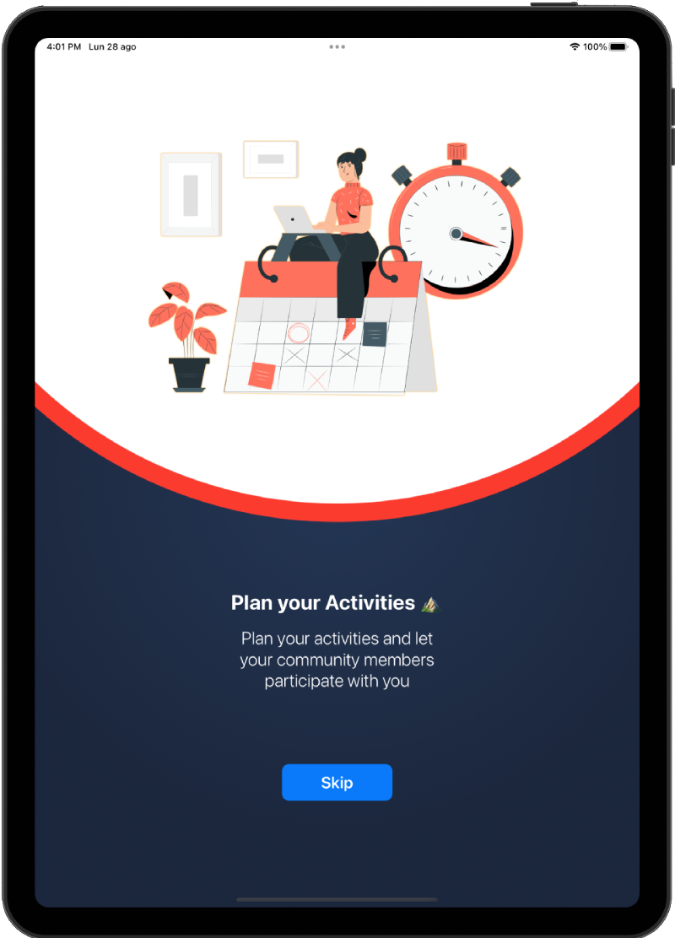




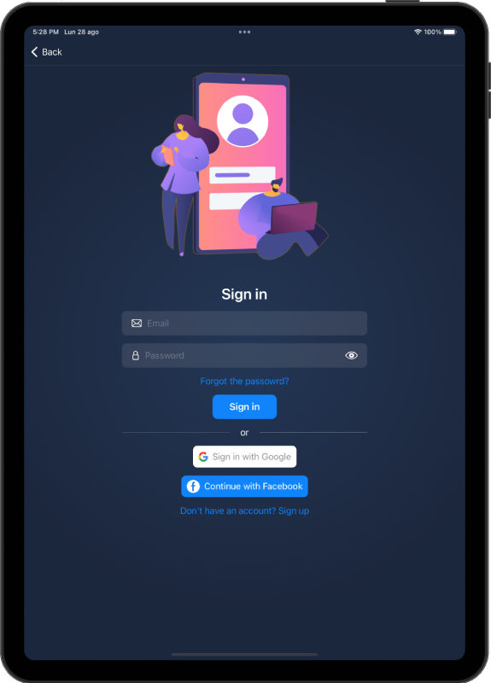


External Services
Firebase Authentication
Google Authentication
Facebook Authentication
Firestore
Firebase Storage
Healthkit
Mapkit

Slide 5
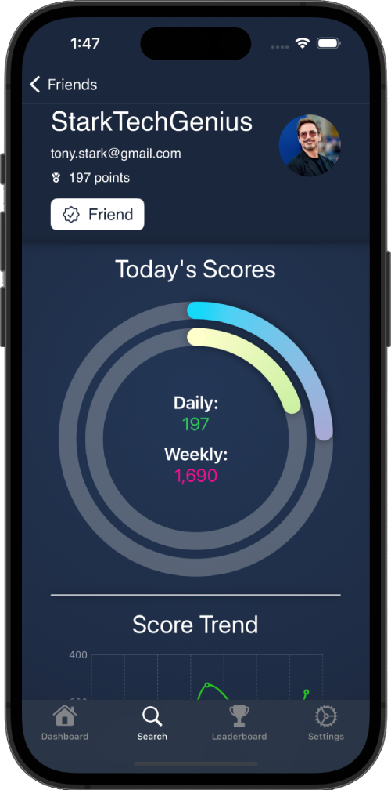
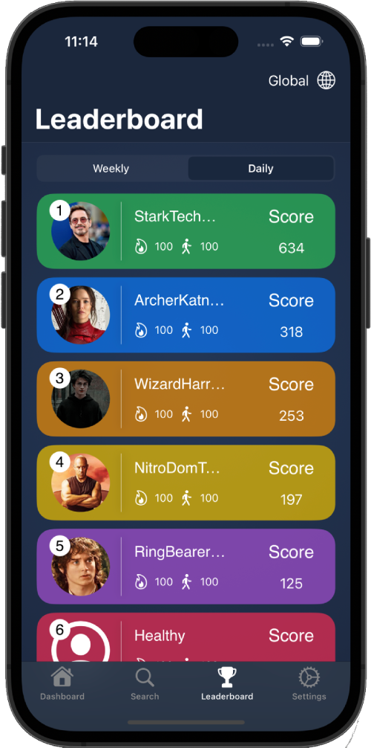
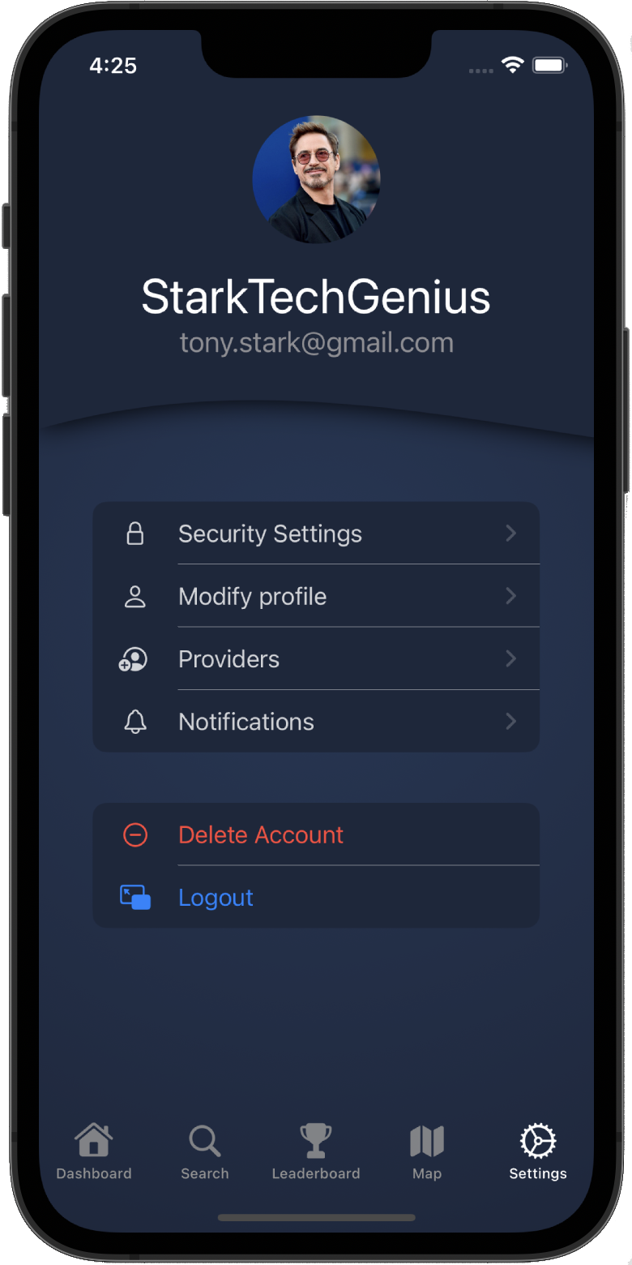


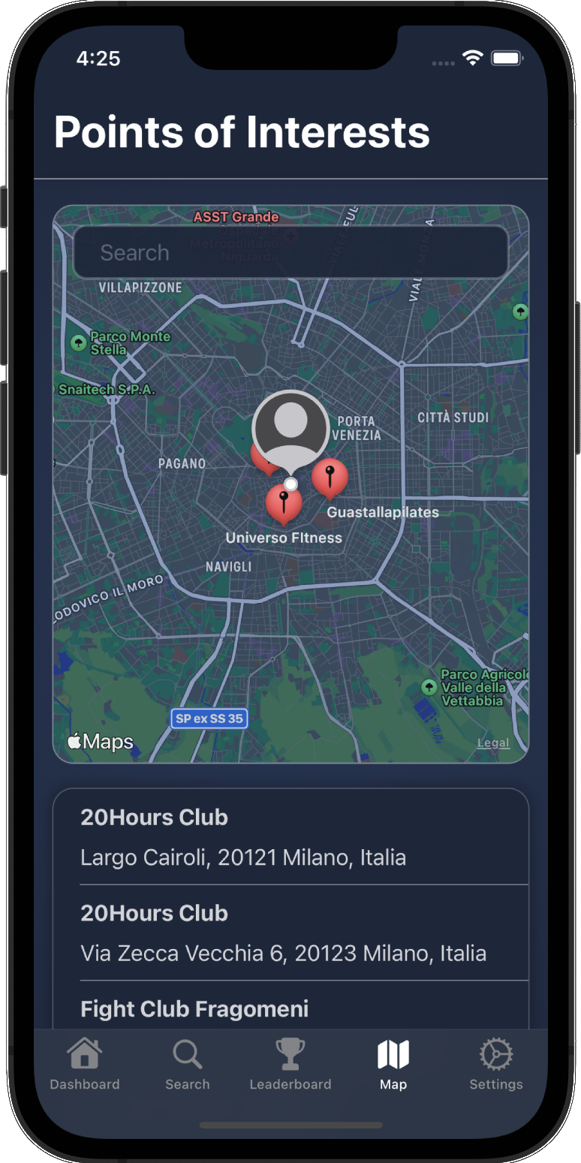
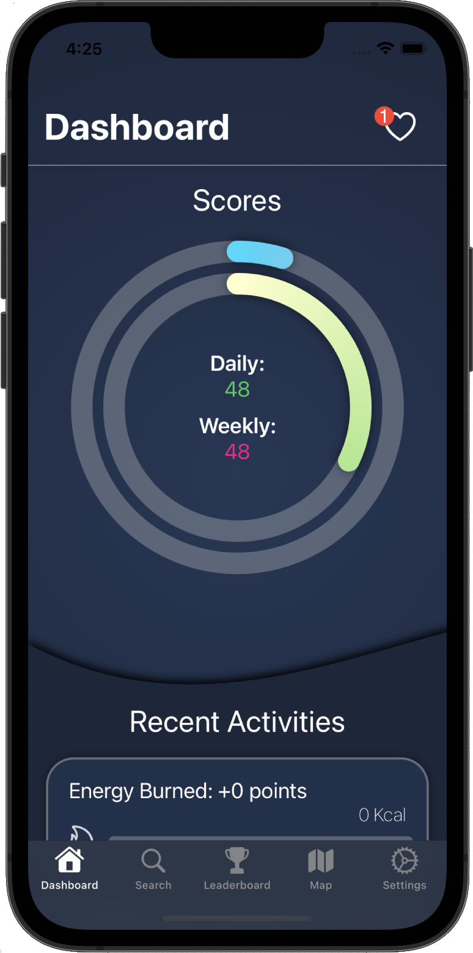
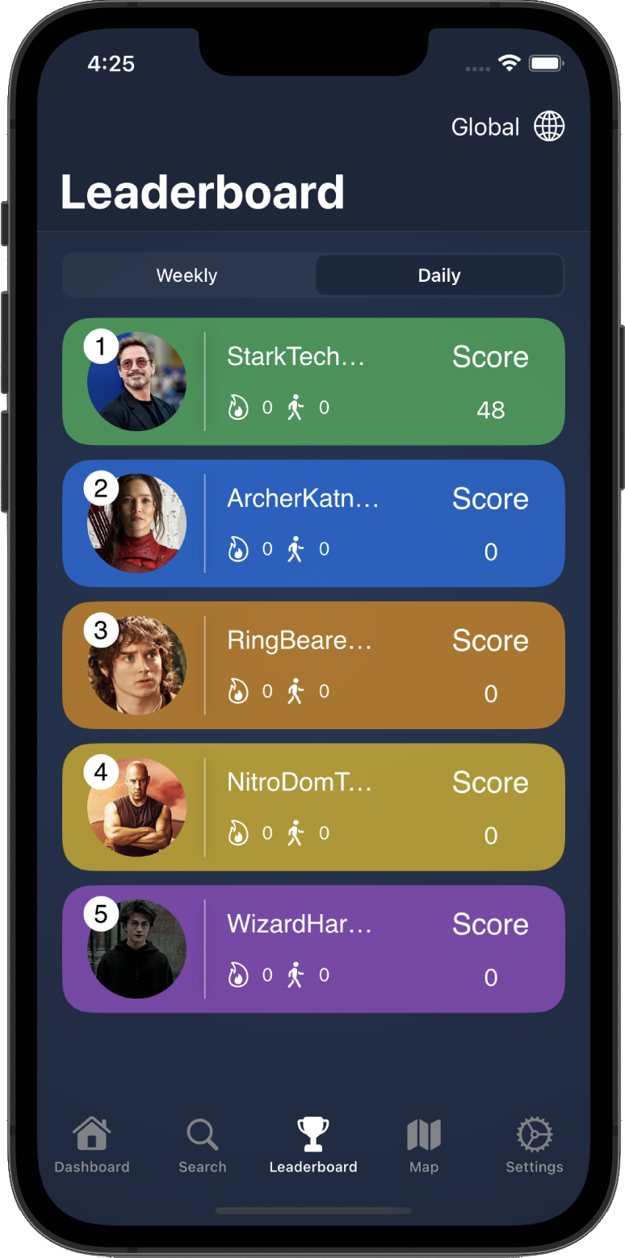
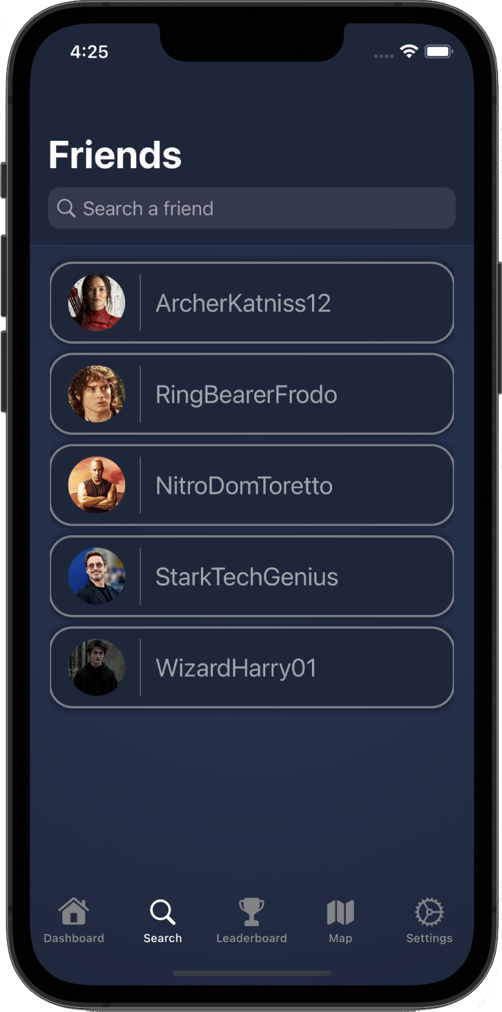
Device Services
Notifications
Geo-Localizations
Connectivity

Slide 6
iPhone

Slide 7
iPhone

Slide 8
iPhone

Slide 9
iPhone

Slide 10
iPhone

Slide 11
iPhone

Slide 12
iPhone

Slide 13
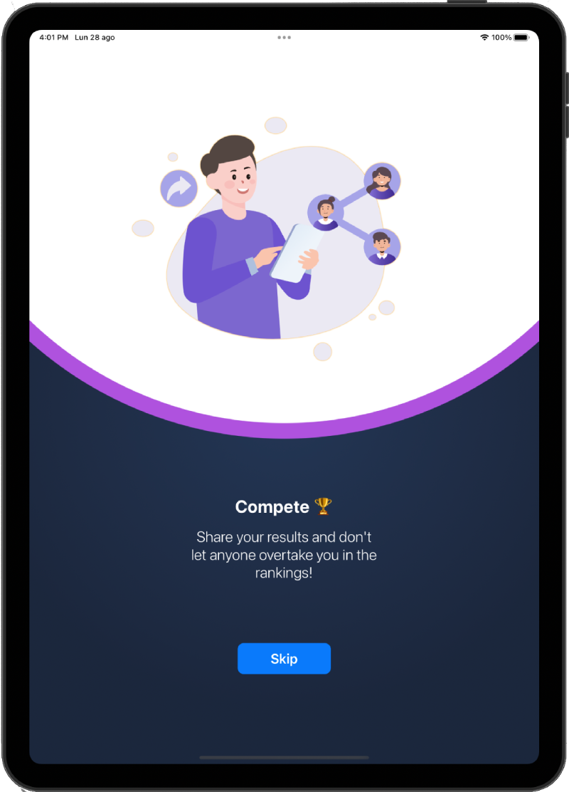
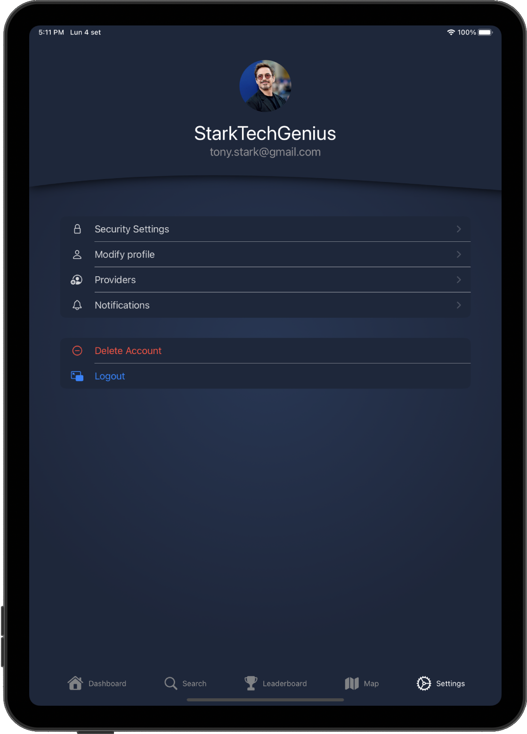
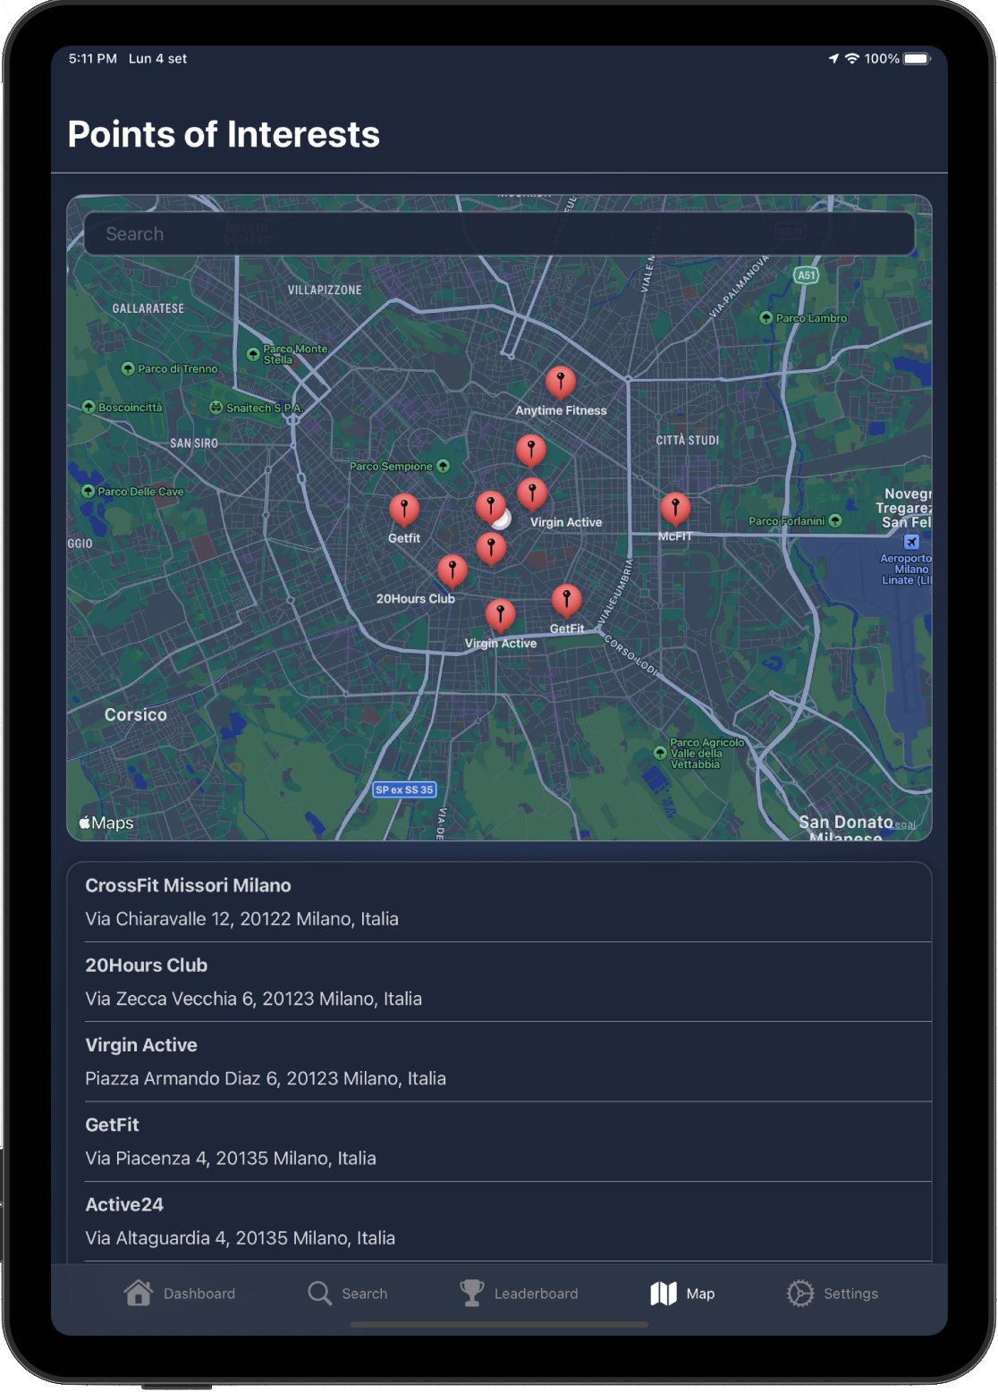
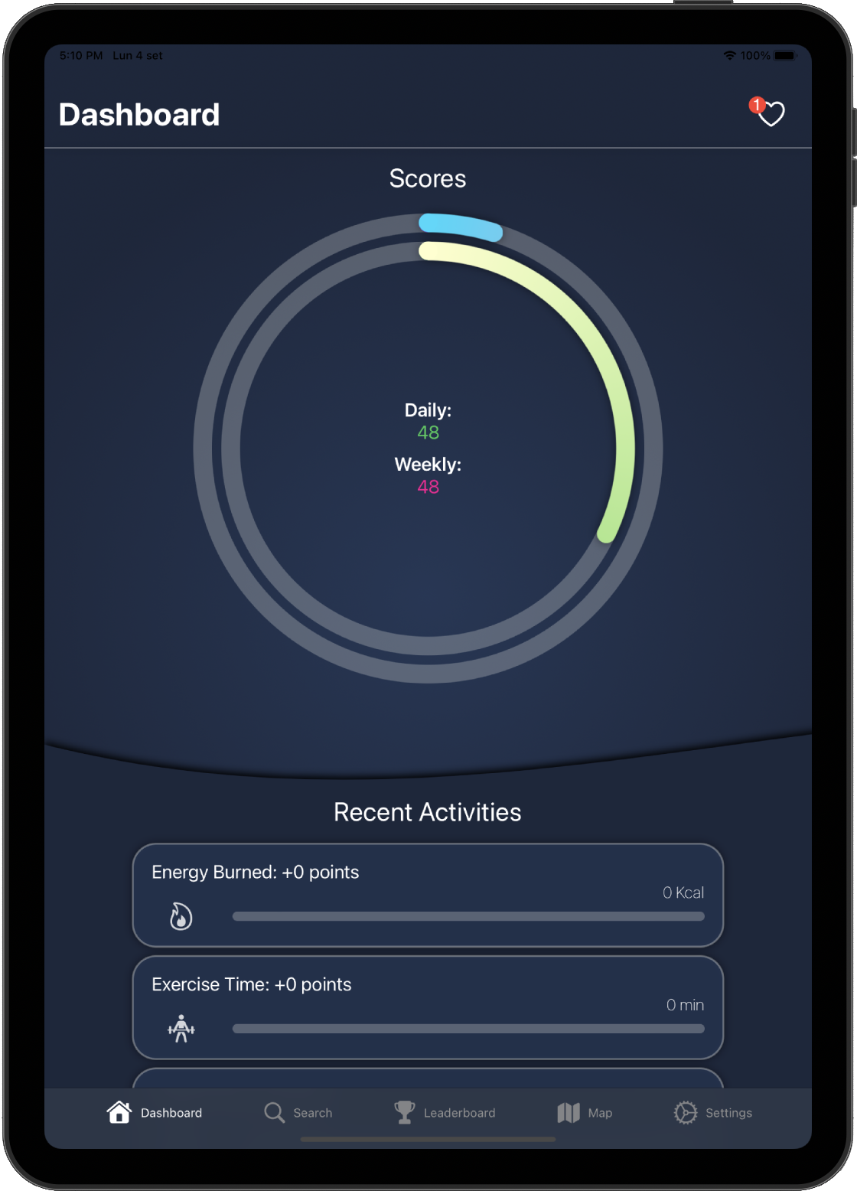
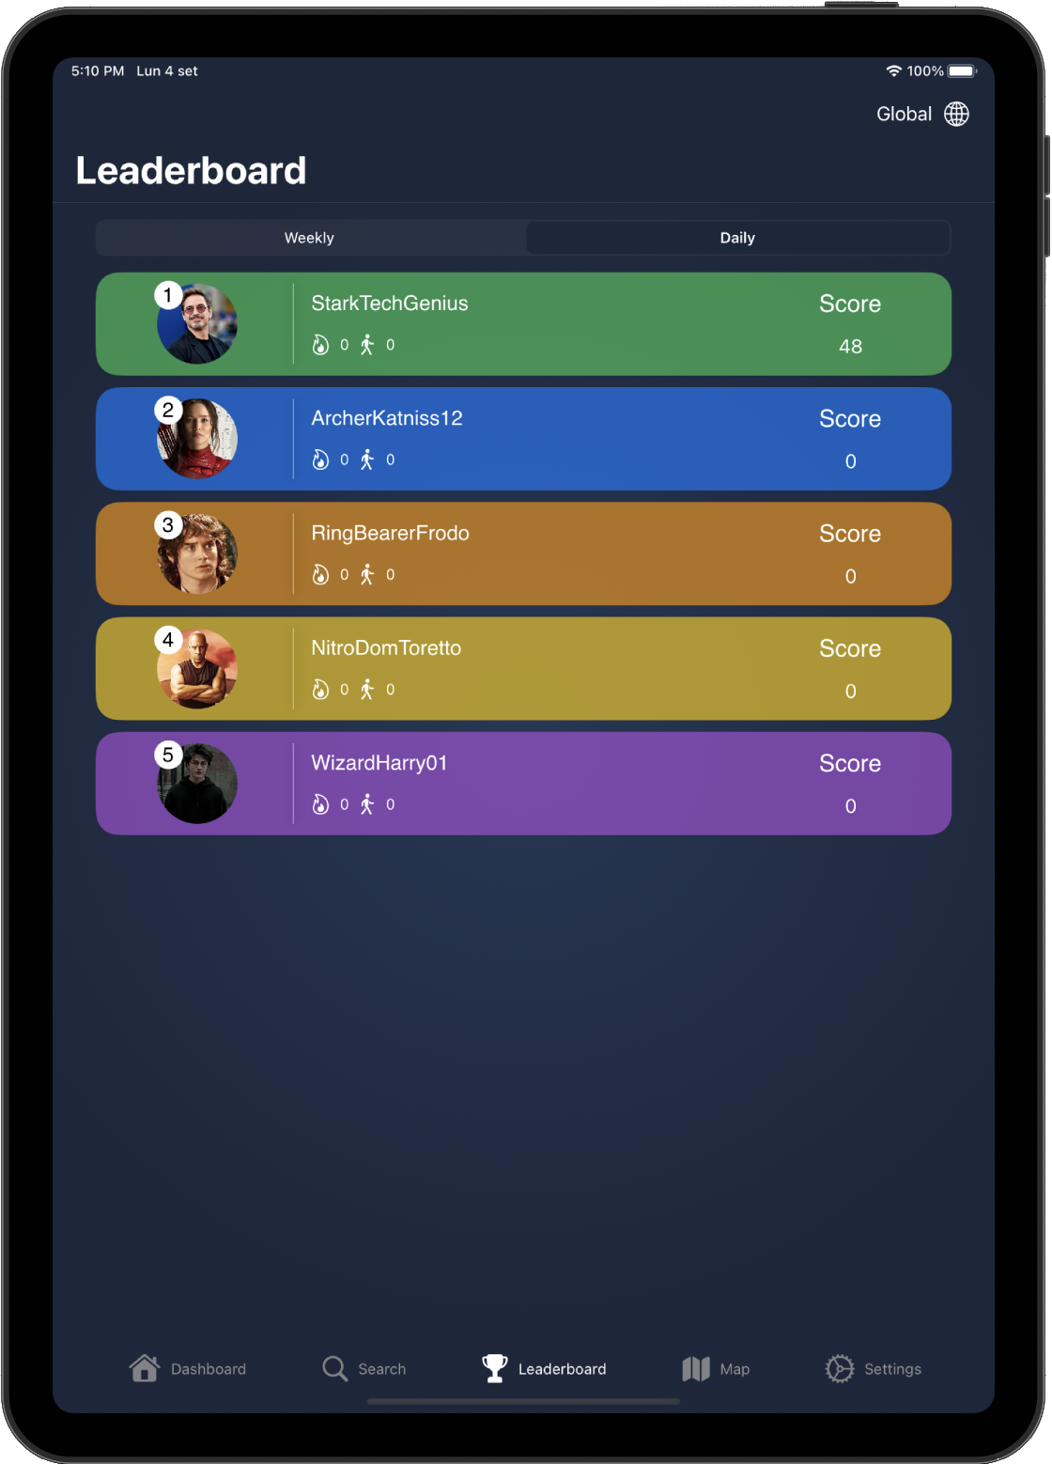
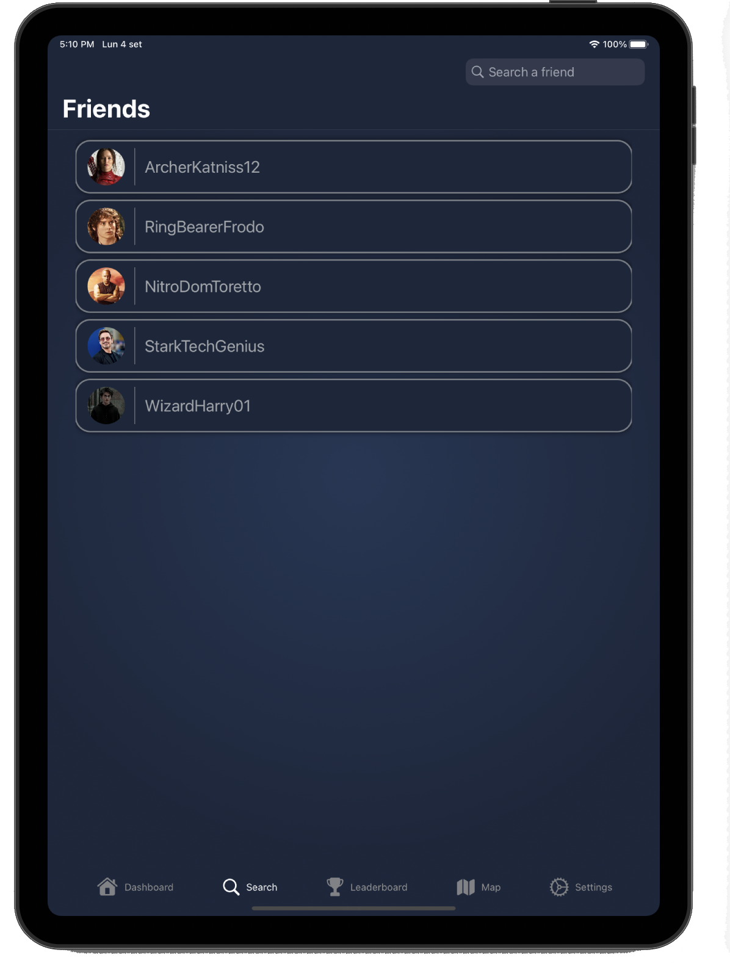
iPad

Slide 14
iPad

Slide 15
iPad

Slide 16
iPad

Slide 17
iPad

Slide 18
iPad

Slide 19
iPad

Slide 20
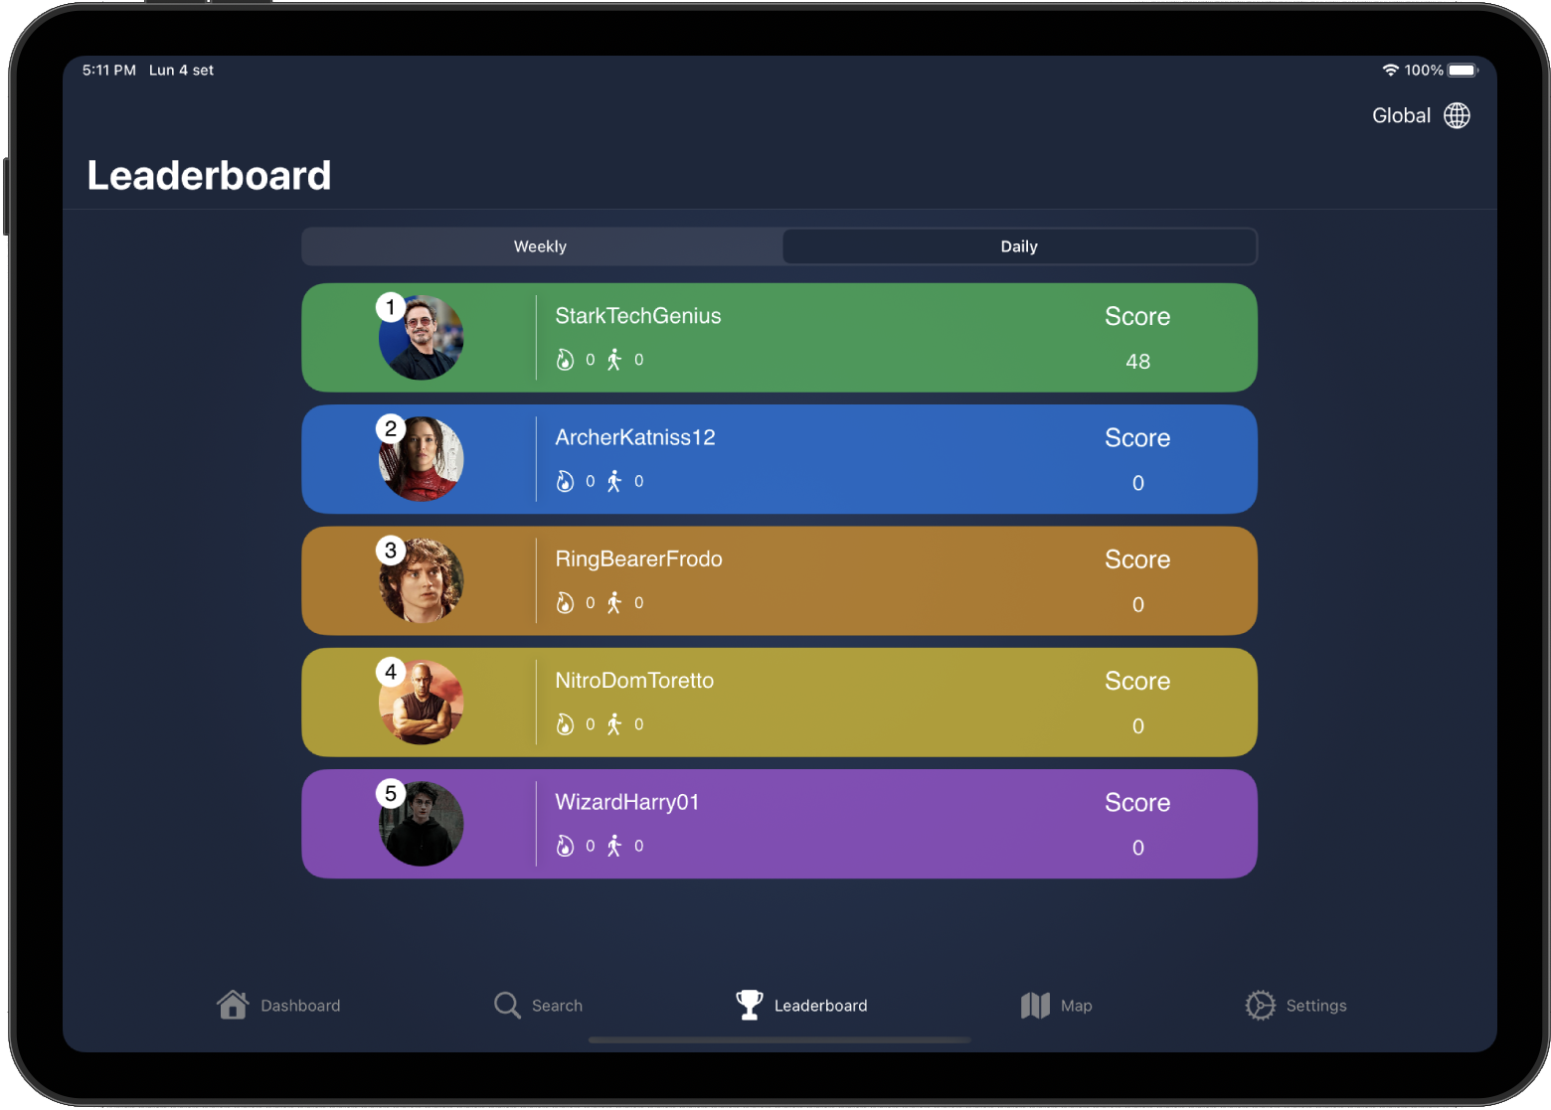
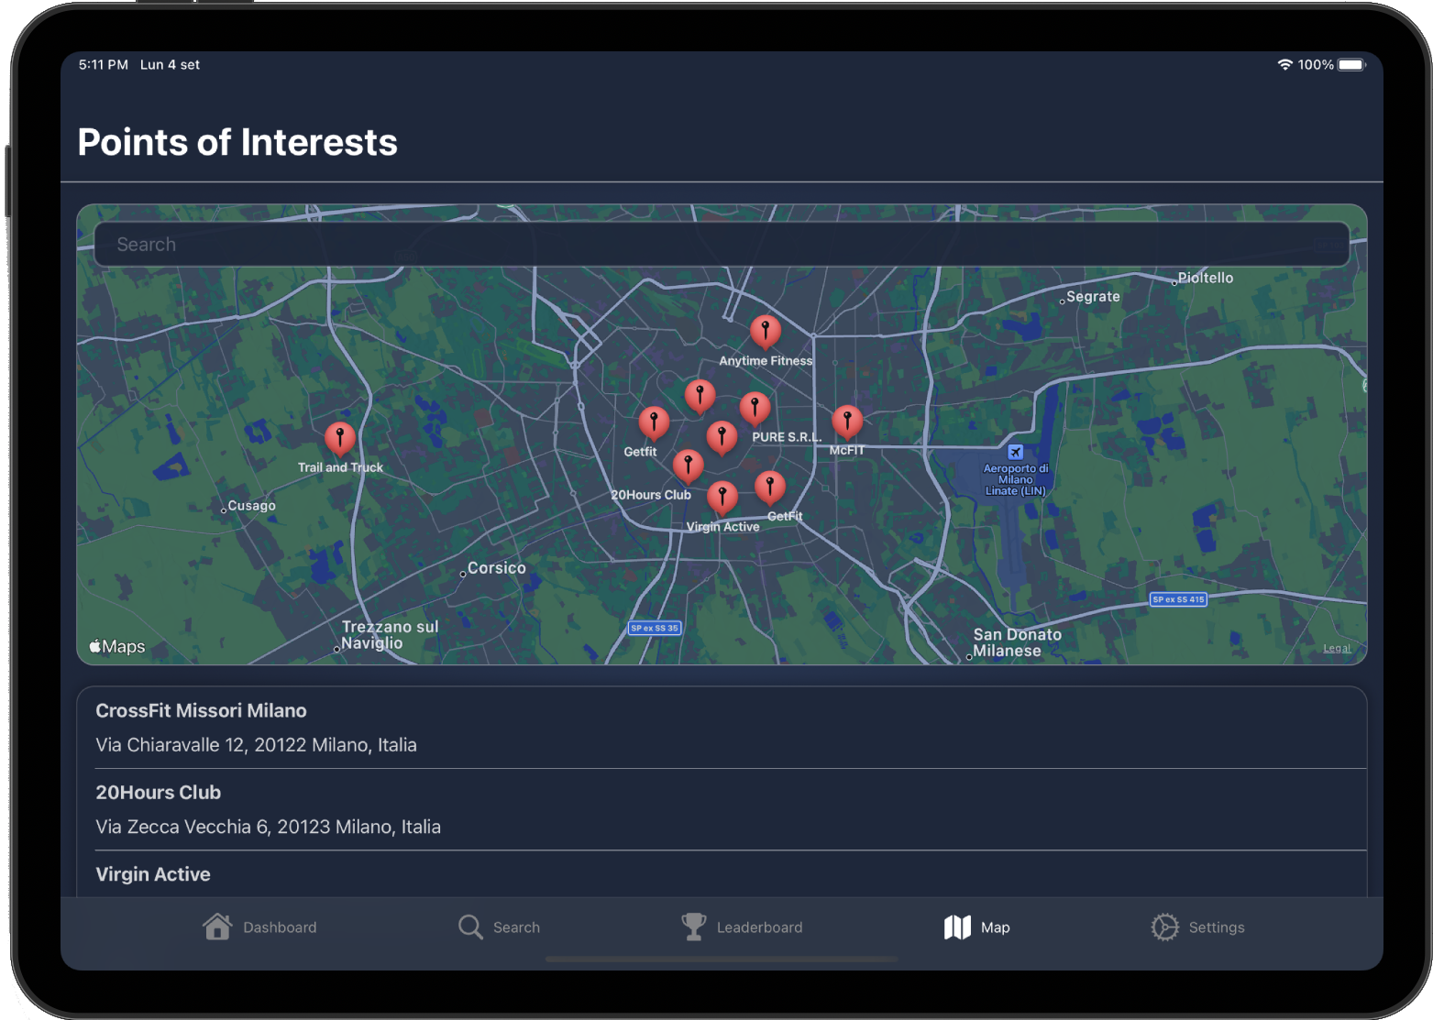
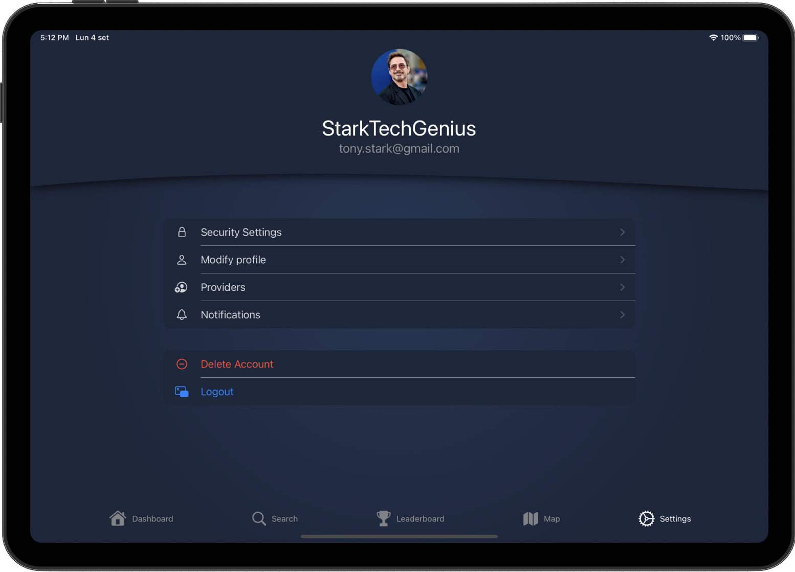
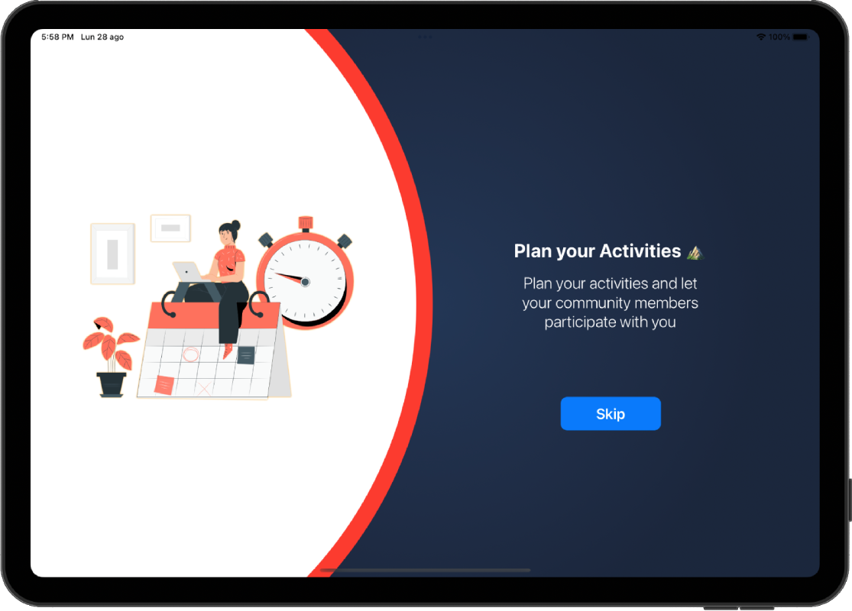
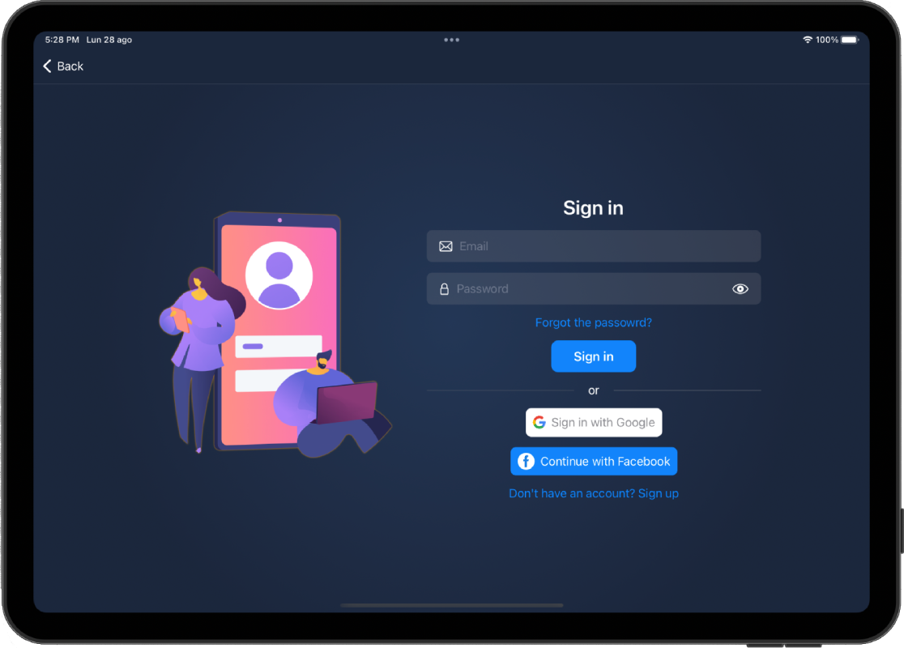
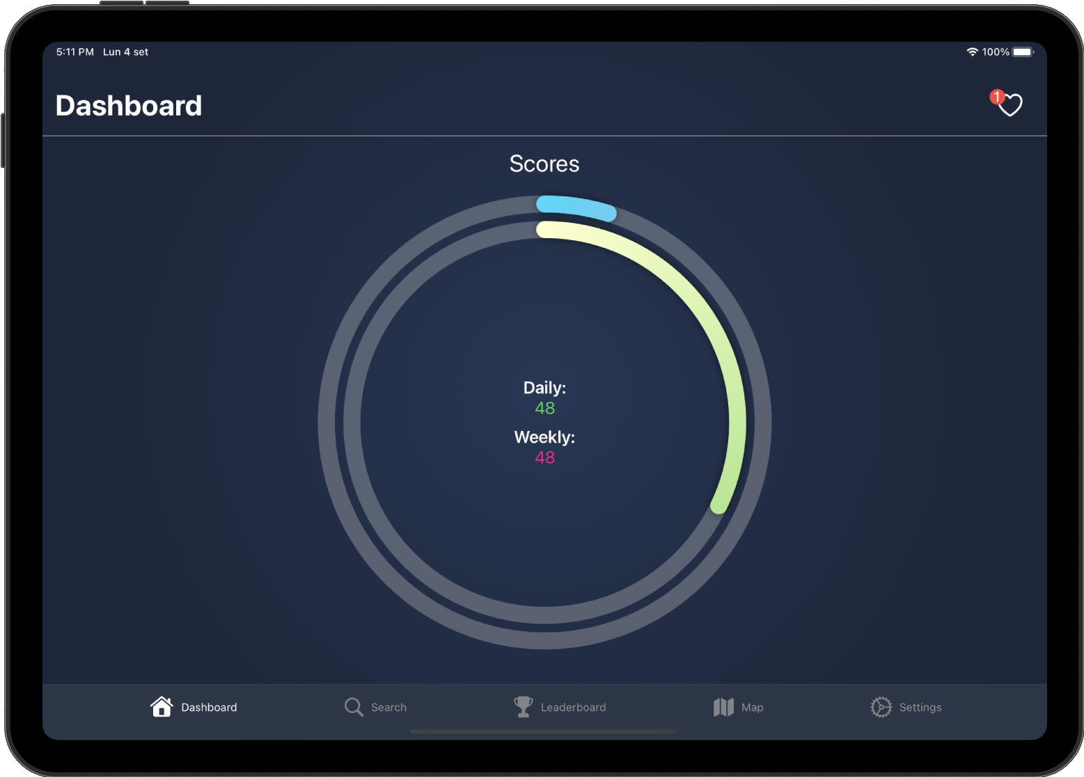
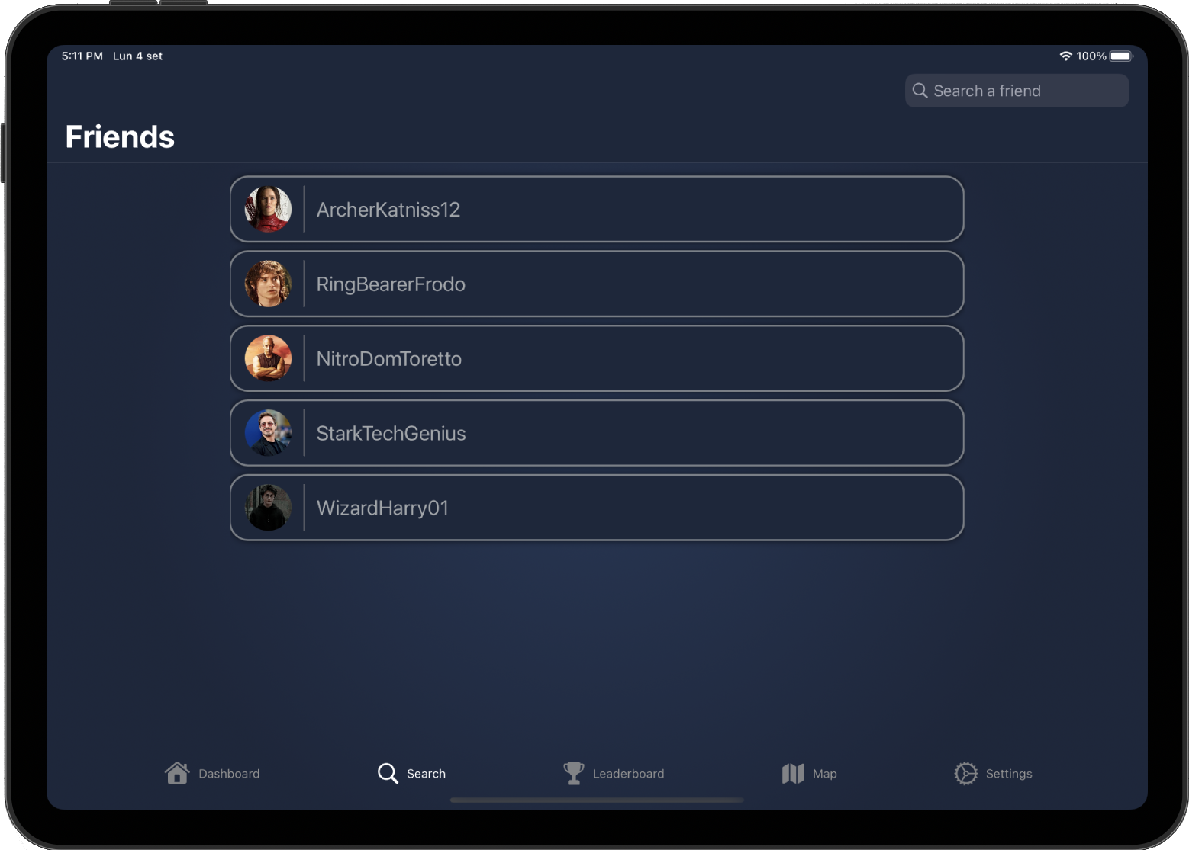
iPad

Slide 21
iPad

Slide 22
iPad

Slide 23
iPad

Slide 24
iPad

Slide 25
iPad

Slide 26
iPad

Slide 27

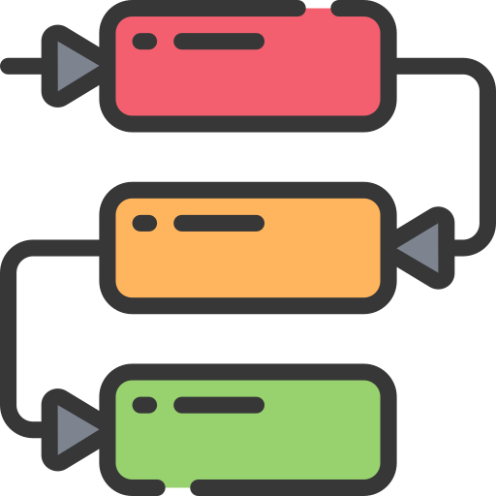


Testing
Unit Testing
Dependency Injection
Mock Objects
UI Testing

Slide 28

Thank you for you attention!
manuela.merlo@mail.polimi.it
riccardo.inghilleri@mail.polimi.it

